Slide 1

Data Analytics Project – Real Estate in California
Student name - Shruti Bhalotiya
Net ID - eg7732

Slide 2
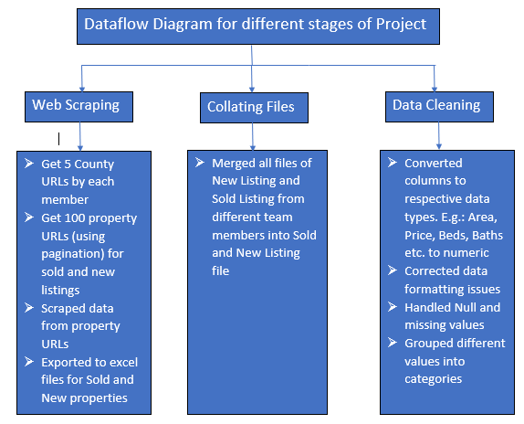
We managed to extract , clean and load the data for our individual analysis
Recap

Slide 3
Analysis 1
Problem Statement :
Find the “top performing” counties in California
“Top Performing County”: is a county which has seen a hike in the price per sq.ft compared to the price per sq. ft of properties sold.

Slide 4
Find the average price per sq. ft of all the sold properties in each county
Find the average price per sq. ft of all the new properties listed in each county
Find the percent change in the 2 prices (Sold price and new price) for each county
Counties which have seen maximum increase in average price per sq. ft are the top performing counties
Analysis 1 : APPROACH

Slide 5
Average price per sq. ft of all the sold properties in each county
Group all the Sold Property listing by county
Loop through each county
Add the “per sq. ft” price for each property for a county
Divide this by number of properties in each county
Formula (for each county):
∑(per sq. ft) for each sold property / Number of properties
Analysis 1 : Step 1

Slide 6
Average price per sq. ft of all the new listings in each county
Group all the New Property listing by county
Loop through each county
Add the “per sq. ft” price for each property for a county
Divide this by number of properties in each county
Formula (for each county):
∑(per sq. ft) for each new property / Number of properties
Analysis 1 : Step 2

Slide 7
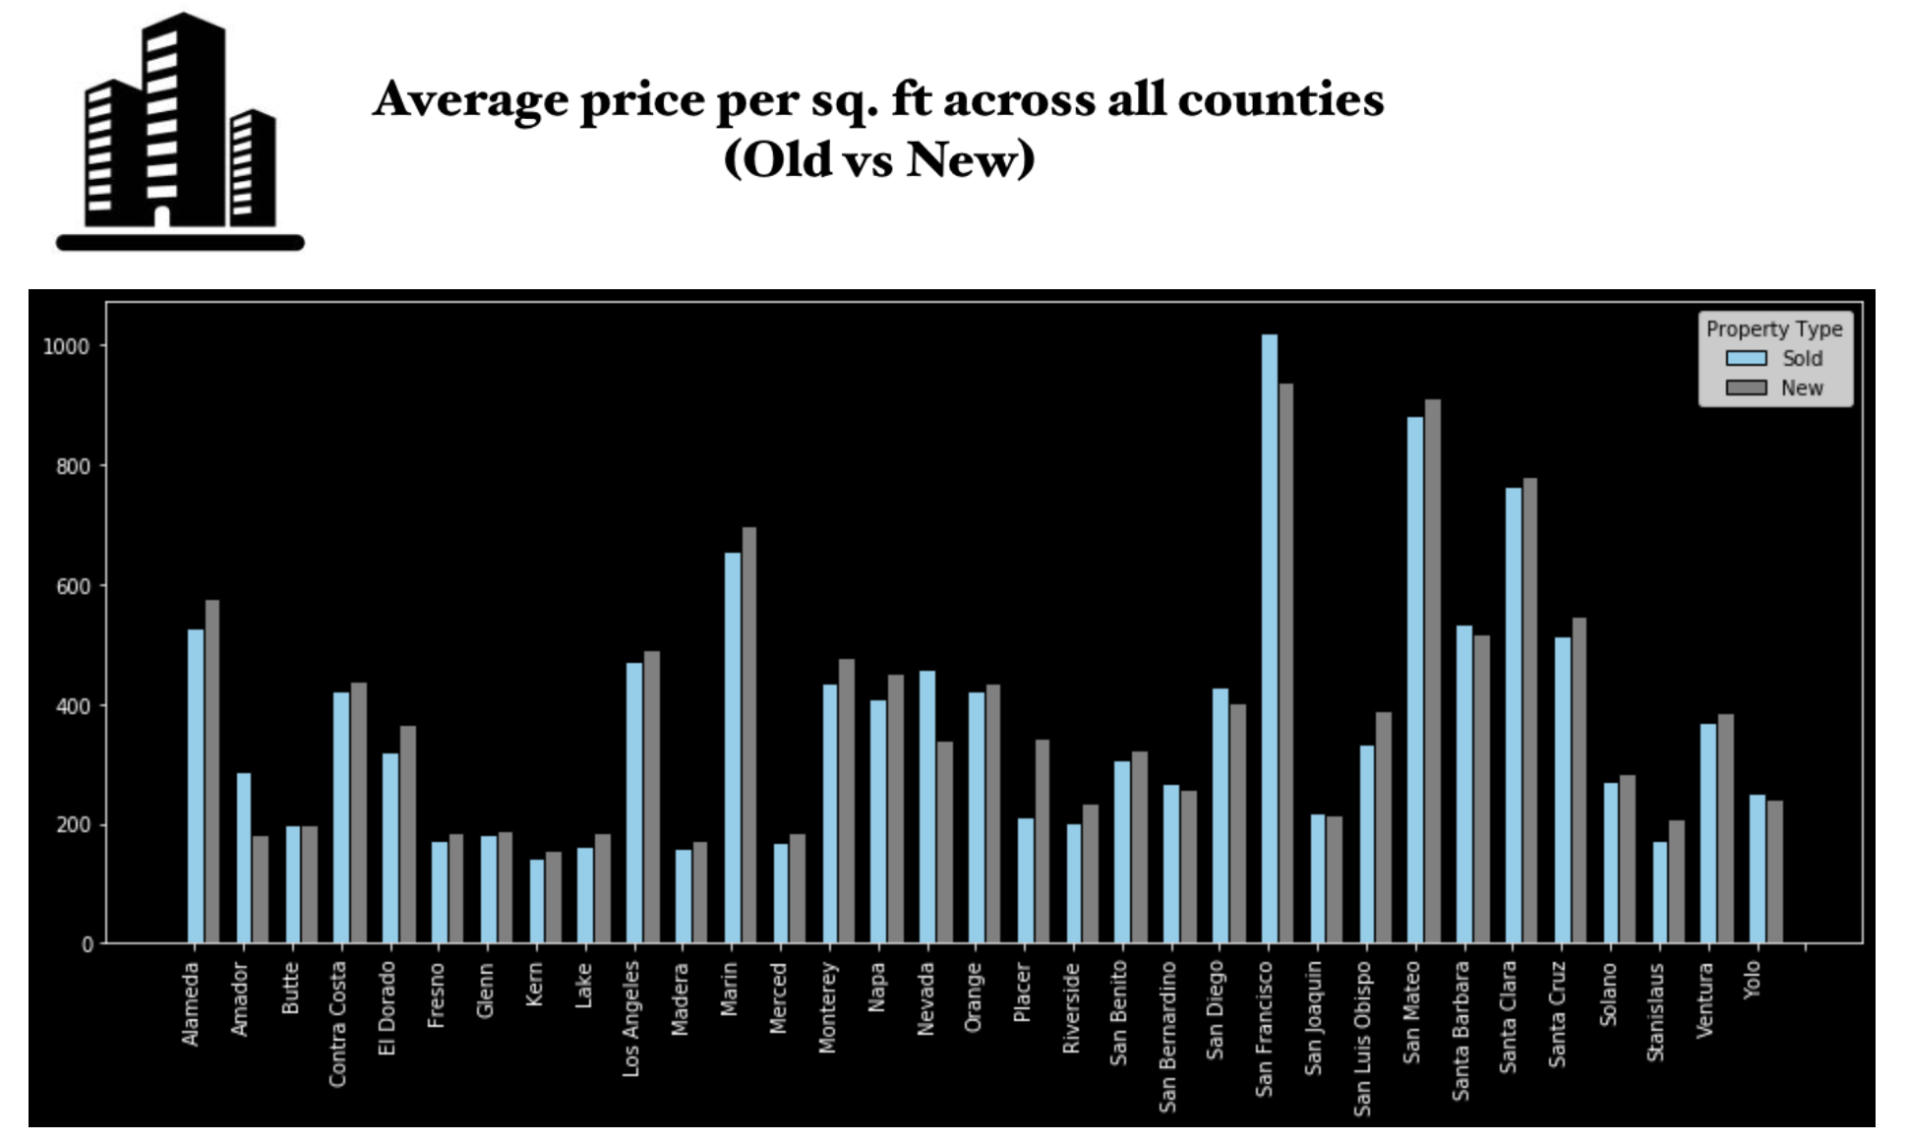
Analysis 1 :
Graph 1

Slide 8
Percent change in the 2 prices for each county
X= Avg price per sq. ft for sold property for each county
Y= Avg price per sq. ft for new property for each county
Percent change = [(X –Y)/X]*100
Analysis 1 : Step 3

Slide 9
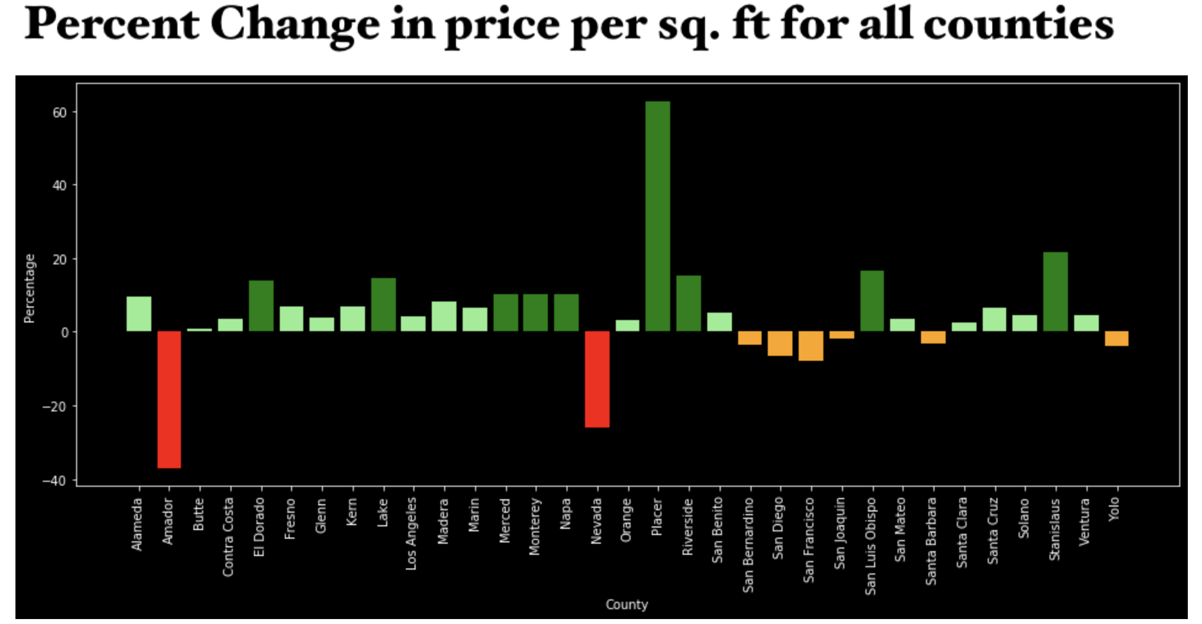
Analysis 1 : graph 2

Slide 10
Counties with maximum change in price per sq. ft
Loop through each county
Map the percent change in price per sq. ft against the county
Plot 2 graphs :
Top 10 performers (counties that have seen maximum spike in avg price per sq. ft)
Bottom 10 performers (counties that have seen maximum fall in avg price per sq. ft)
Analysis 1 : step 4

Slide 11
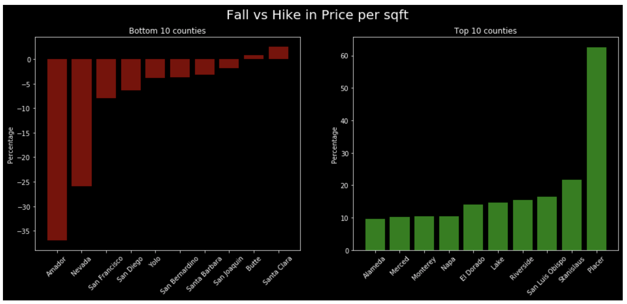
Analysis 1 : graph 3

Slide 12
Conclusion
Amador, Nevada shows drastic fall in price per sq. ft whereas County “Placer” is a performer county
A potential investor can think to buy a property listed in top 10 counties because avg price per sq. ft has increased
Analysis 1 :
Conclusion

Slide 13
Analysis 2
Problem Statement :
Find the “Hot Properties” in Top performing counties
“Hot Property”: is a property available in top performing counties which matches the attributes that are sold the most in the county.

Slide 14
Find the selling trend in top 5 performing counties from Analysis 1 on number of beds, baths, area, locality and property type
Use this analysis to query the new listing data for top 5 performing counties
Provide a visualization to depict the distribution of hot properties in top performing counties
Analysis 2 : APPROACH

Slide 15
Find the selling trend in top 5 performing counties from Analysis 1
Extract data for each top performing county on different attributes like baths, beds, area, locality and property type
Use subplot to provide visualization of each parameter for all counties
Analysis 2 : Step 1

Slide 16
Analysis 2 : Graph 1/5
For e.g. – End user can read this graph as 3 beds are in more demand in Lake county

Slide 17
Analysis 2 : Graph 2/5
For e.g. – End user can read this graph as 2 baths are in more demand in Lake county

Slide 18
Analysis 2 : Graph 3/5
For e.g. – End user can read this graph as 1000-2000 sq. ft area houses are in more demand in Lake county

Slide 19
Analysis 2 : Graph 4/5
For e.g. – End user can read this graph as more houses were sold in the ‘Liverport’ city in Lake county

Slide 20
Analysis 2 : Graph 5/5
For e.g. – End user can read this graph as Single family houses were sold the most across all the counties

Slide 21
Use this analysis to query the new listing data for top 5 performing counties
Eg : From Step 1, for county Lake, we analyzed that the most in-demand property is a “2-3 Bedroom , 2-3 Bathroom, Single Family” home in “Lakeport” with area approximately 2000 sq. ft
Use these conditions to check how many such properties are listed for sell in county Lake
Repeat this exercise for each of the top 5 counties
Create a dataset of the result
Thus, we will get 17 hot properties out of approx. 3600
Analysis 2 : Step 2

Slide 22
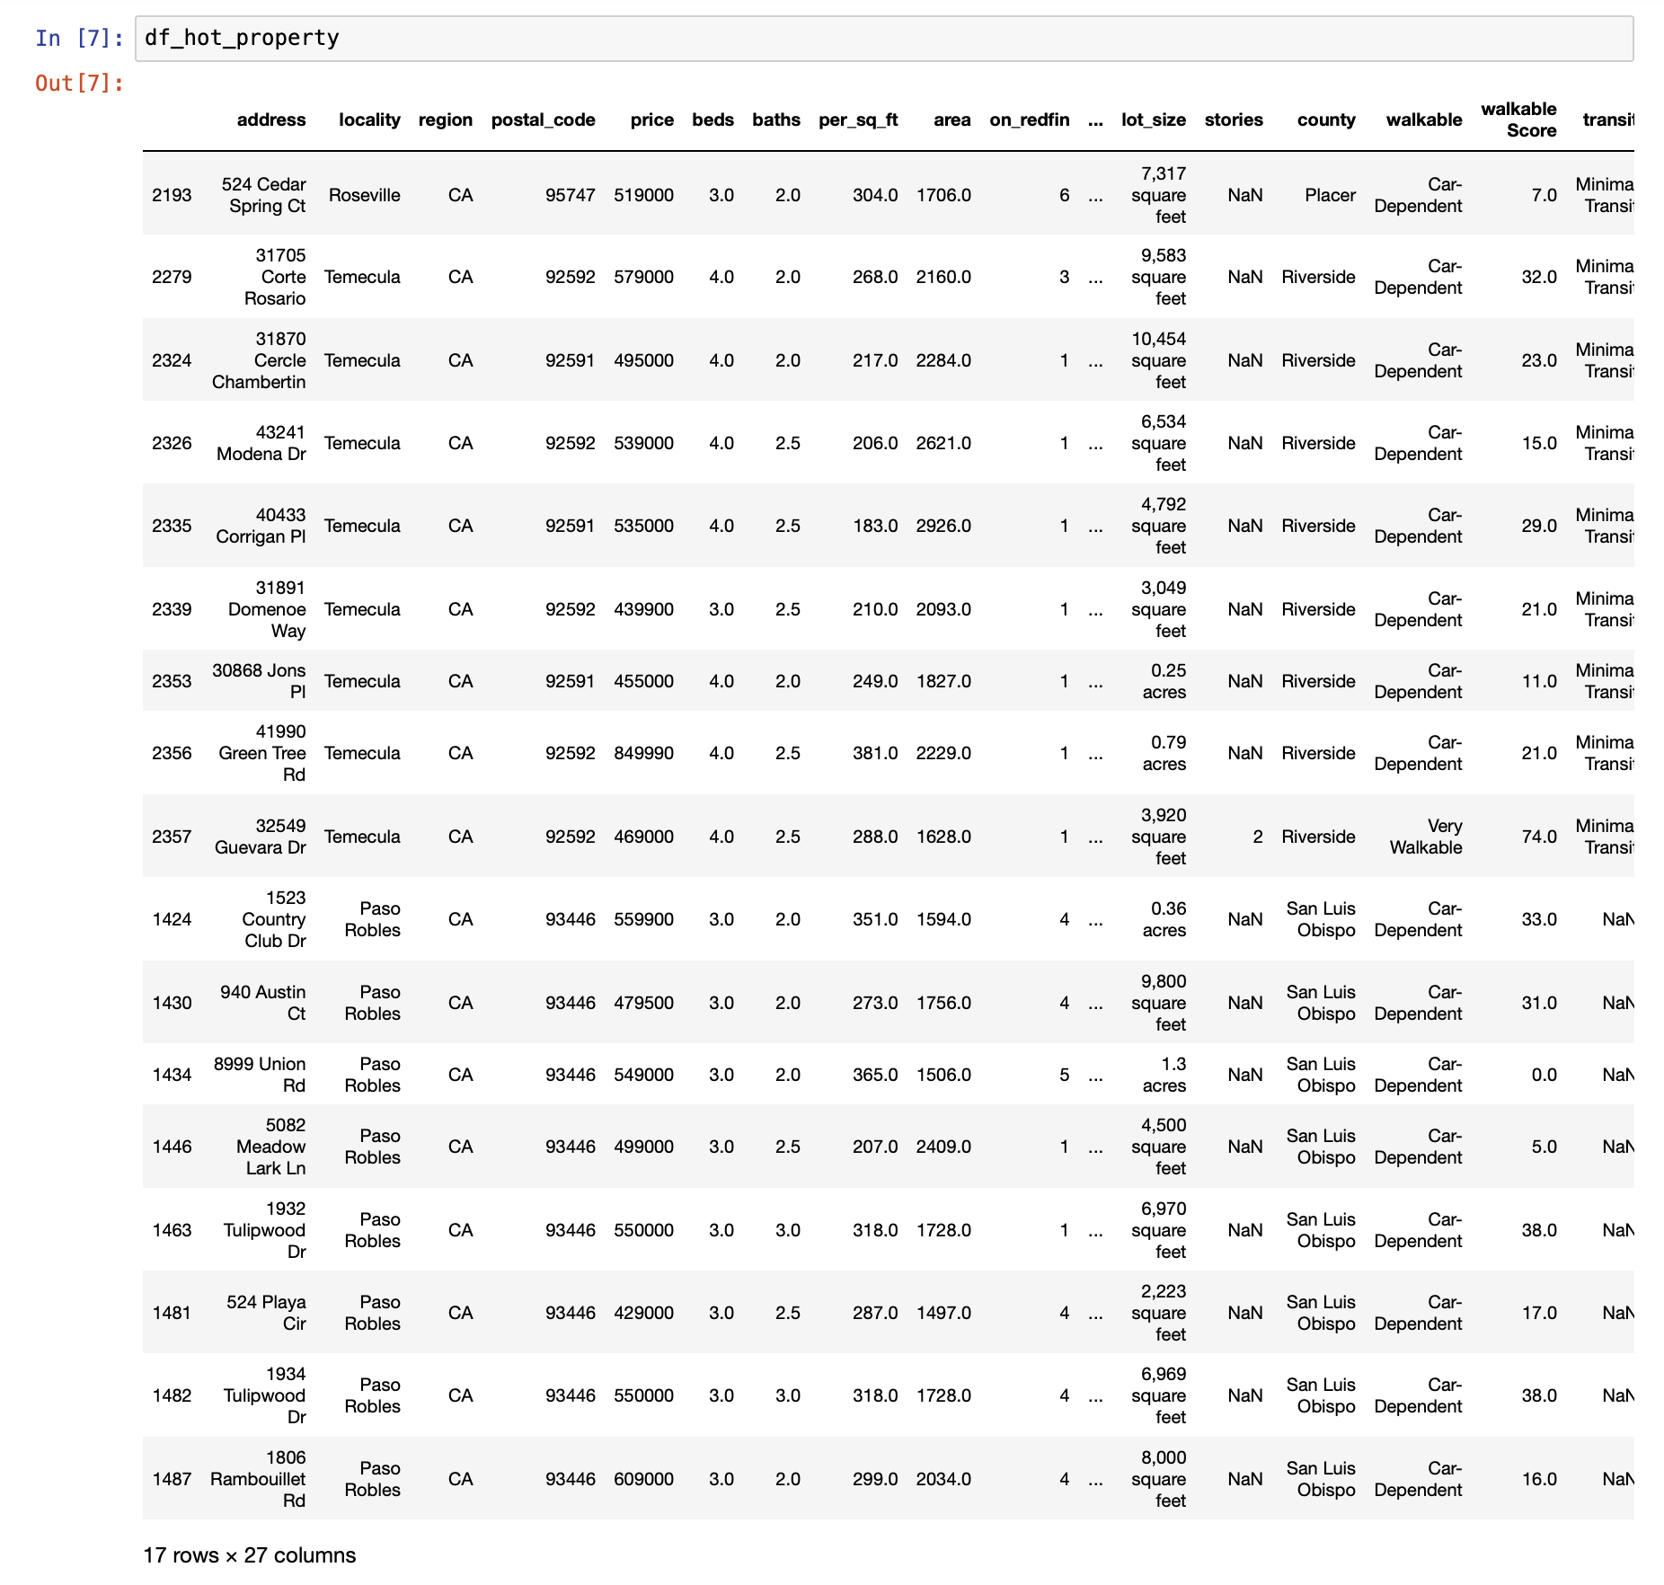
Analysis 2 : Step 2 output

Slide 23
Provide a visualization to depict the distribution of hot properties in top performing counties
Plot a pie chart for the “hot property” from previous step
Use this chart to depict the distribution of hot properties in top performing counties
Analysis 2 : Step 3

Slide 24
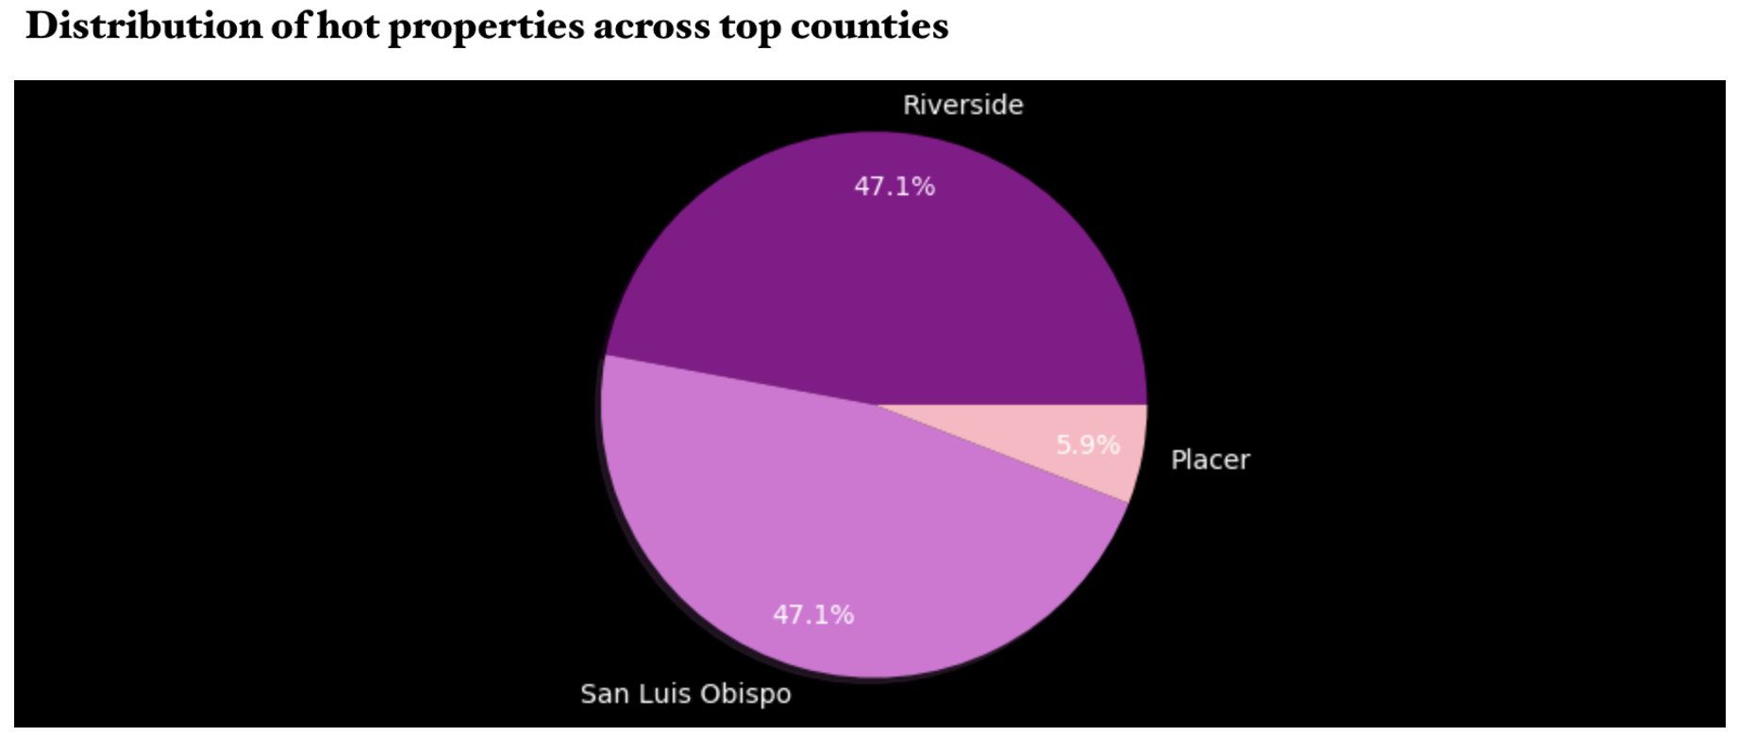
Analysis 2: Graph 6

Slide 25
Conclusion
From Analysis 2, we can conclude that most of the properties are classified as “Hot Property” are listed in county ‘San Luis Obispo’ and county ‘Riverside’
Each of the 2 counties have 8 properties listed which can be a potentially good investment for real estate investors.
Analysis 2 :
Conclusion

Slide 26
Analysis 3
Problem Statement :
From the Hot Properties, can we predict the Best Properties for investment?
“Best Property”: is a property available in top performing counties which has price per sq. ft less than average price per sq. ft in a particular county

Slide 27
Use the Hot Properties list from Analysis 2
Loop through each property and compare the price per sq. ft to the average price per sq. ft of all the sold properties in that county
Mark the properties which has price lesser than or equal to the average price per sq. ft of sold properties
At the end, we will have a list of Best Properties (7 best properties out 17 hot properties) for investment
Analysis 3 : APPROACH

Slide 28
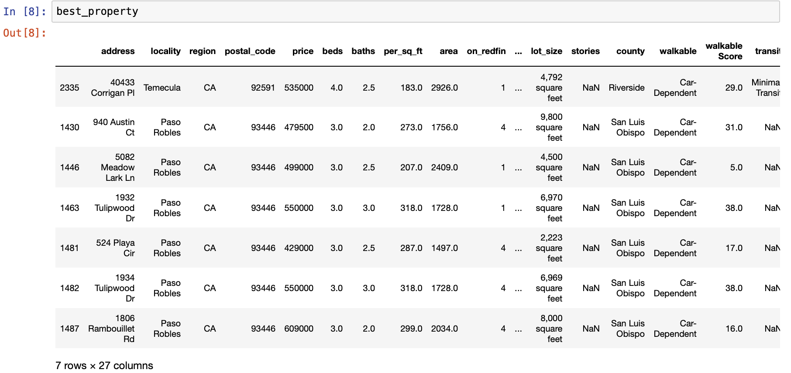
Analysis 3 : Output

Slide 29
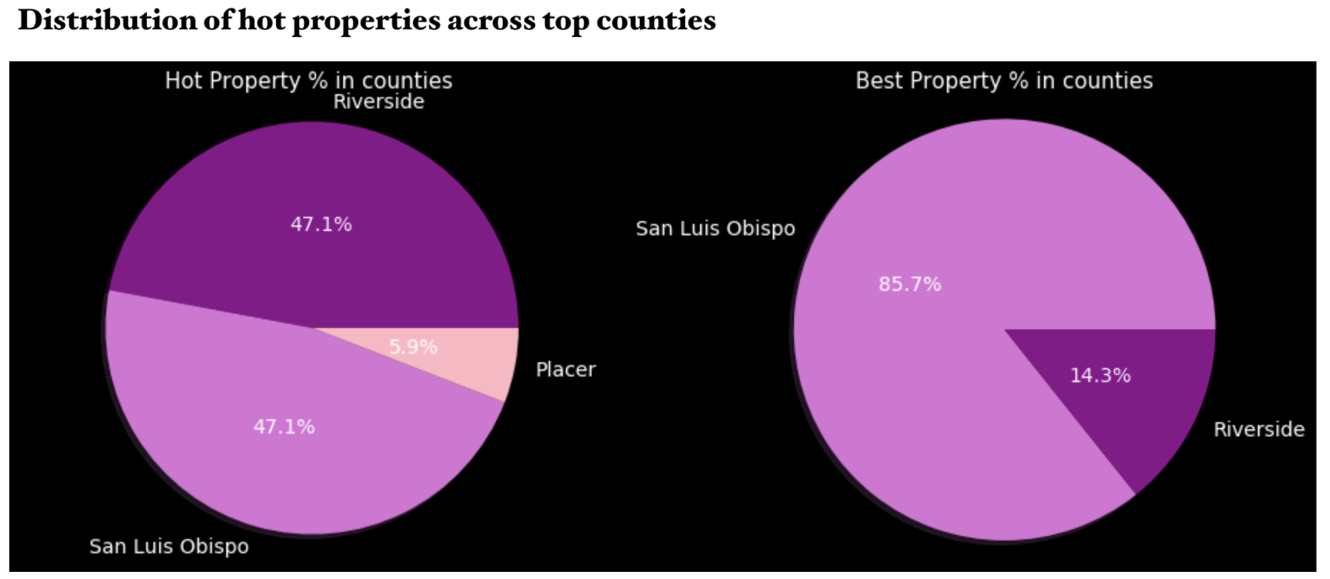
Analysis 3

Slide 30
Conclusion
From Analysis 3 , we can conclude that properties in ‘San Luis Obispo’ are the best properties for investment purposes
In this county, properties were sold in the past at the rate of $333 per sq. ft on an average
New properties are listed at $389 per sq. ft , thus an average hike of 16.5% in property rate making this county as one of the top performing counties in California
This county has 8 properties listed that matches the criteria of most frequently sold property types in the past
Out of these 8 properties, 6 properties today are listed at a price less than $389 per sq. ft, which is the average property rate in this county
This makes these 6 properties as the “Best Properties” in California to invest
Analysis 3 :
Conclusion

Slide 31
Project Analysis
The goal of this project is to identify the best properties for investment in California
We started our analysis with more than 3000 listings across 36 counties in California
Using different data points and data analysis, we narrowed down the list to 17 hot properties across top 3 counties in California
We pushed our analysis further to get a precise list of best properties for investment and came up with 6 properties in 1 county
The beneficially of this analysis are potential investors, real estate brokers, construction companies etc.
Overall
Conclusion

Slide 32
Putting all together

Slide 33
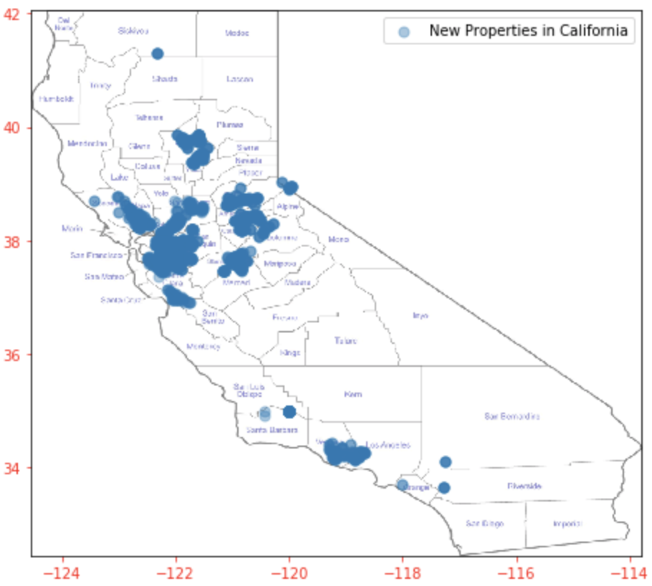
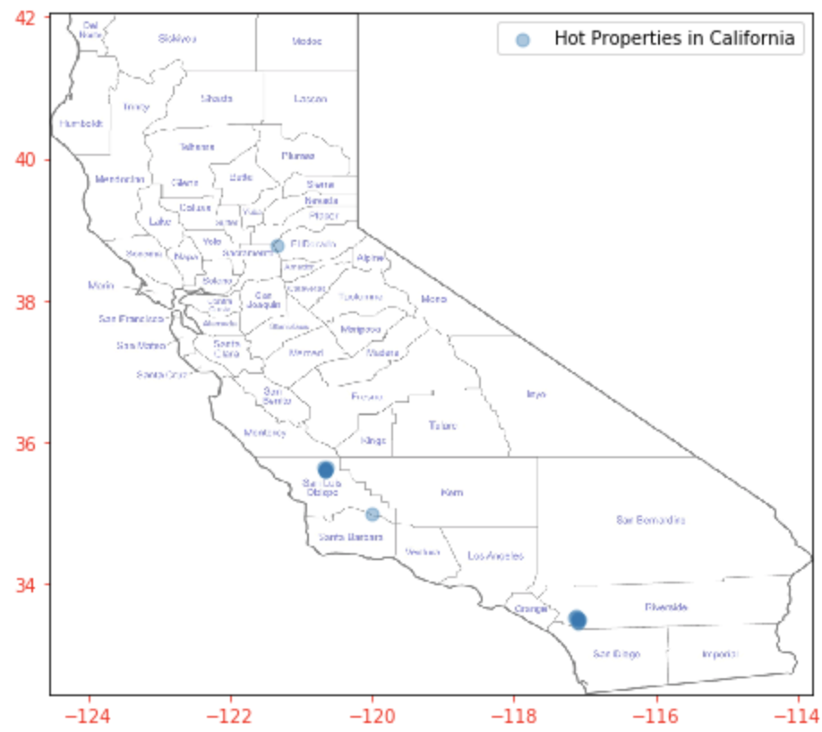
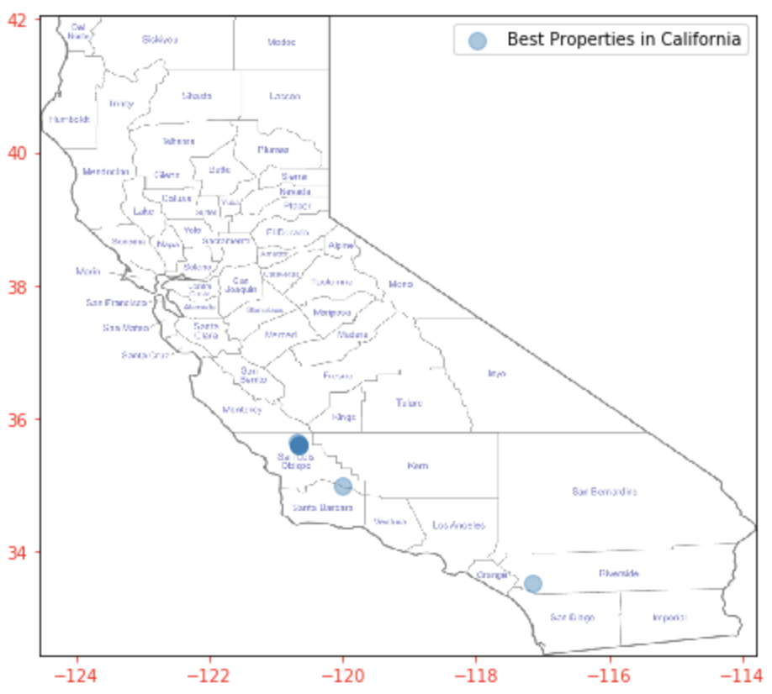
Scatter map plot for New Listing, Hot Listing and Best Listing

Slide 34
Additional visualizations & Highlights of the project

Slide 35
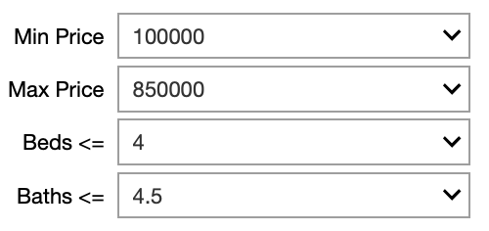
Interactive bar graph for new listing to check the availability of the properties based on user selection
From the drop down, end user can select his/her requirement and get the result of new listing for California State (~3600 properties across 36 counties)
VISUALISATION 1

Slide 36
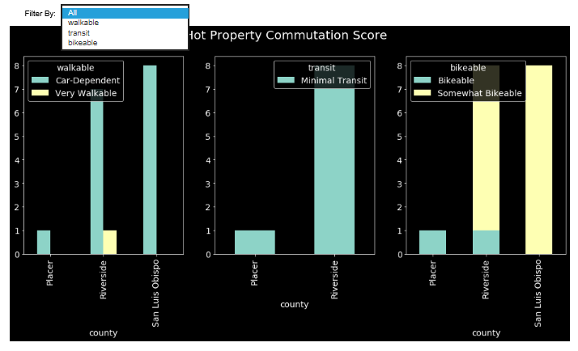
Interactive Crosstab graph to compare hot properties based on commute scores
VISUALISATION 2

Slide 37
Plotting all properties on California Map
VISUALISATION 3

Slide 38
Plotting hot properties on California Map
VISUALISATION 5

Slide 39
Plotting best properties on California Map
VISUALISATION 6

Slide 40
Challenges faced
Forbidden Error while extracting data from Redfin
As compared to other sites some attributes like Type, Transit etc. had lot of sub-categories in Redfin
Mixed type of same attribute as Price were present as both Text and Numeric
Fetching latitude and longitude for the address using geopy.geocoders library
Imposed California map on the scatter plot to display as property listing on map
Challenges

Slide 41
What we learnt
Explored various python libraries
Learnt how to implement interactive graph
Learnt how to fetch latitude and longitude for address
Learnt how to add image as a header
Overall good python hands on practice
Learnt how to add image in the header
Learnt how to insert background style in the graph (‘dark_background’ is used for this project)
Learning

Slide 42


